Slide 1




SUGCZ 2024
Sitecore And Artificial intelligence
SUGCZ
Unlocking the power
21st September 2024, Prague
José Neto
Solutions Architect
Main sponsor

Slide 2


SUGCZ 2024
SUGCZ
Today's Speaker
José Neto
Solutions Architect
  Brazilian
  9 Years of Experience on Sitecore Platform
  Sitecore MVP 2018-2024 (7x)
  Sitecore Content Hub Certified
  Sitecore 8, 9 , 10 Certified
  Blogging
  Sitecore Community Mentor Program
  Go Horse - Sitecore Hackathon Team Member
[Image placeholder]
joseneto

Slide 3
SUGCZ 2024
SUGCZ
Headline
Agenda
  Retrieval-Augmented Generation (RAG)
  Search concepts
  AI Models and concepts
  AI and Sitecore (use cases and tools)
  QA
SUGCZ

Slide 4
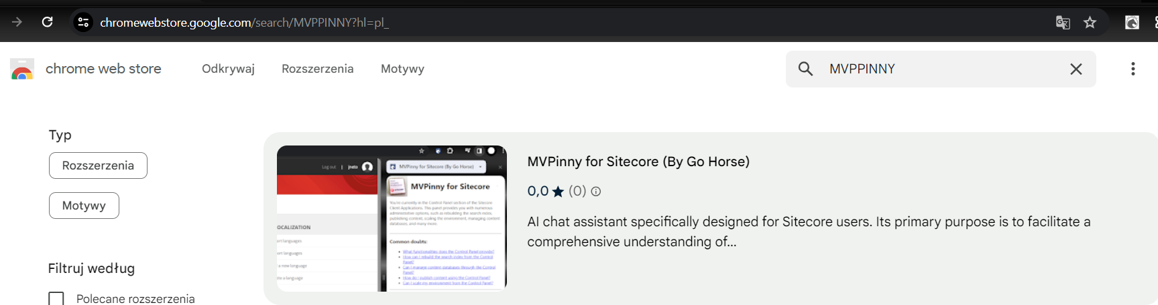




Sitecore Hackathon 2024
SUGCZ 2024
SUGCZ
Best use of AI
Best Module for XM/XP or XM Cloud
MVPPinny: AI Chat Assistant for Sitecore Users
Available in Chrome Store
Winner (2x)
Participations (8x)
Download now !
2016-2024

Slide 5
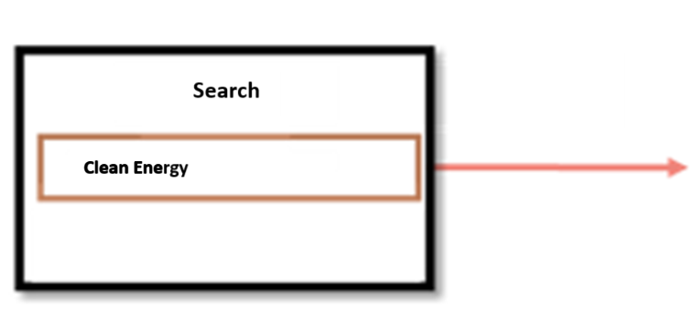


Challenge
SUGCZ 2024
SUGCZ
Assess the use of AI tools to enhance the search functionality of the website by leveraging AI
Technologies Involved :
  CMS Plataform : Sitecore
  Search Tools : Coveo and ElasticSearch
  Models : ChatGPT / Meta-Llama3 (open source)
Banking

Slide 6
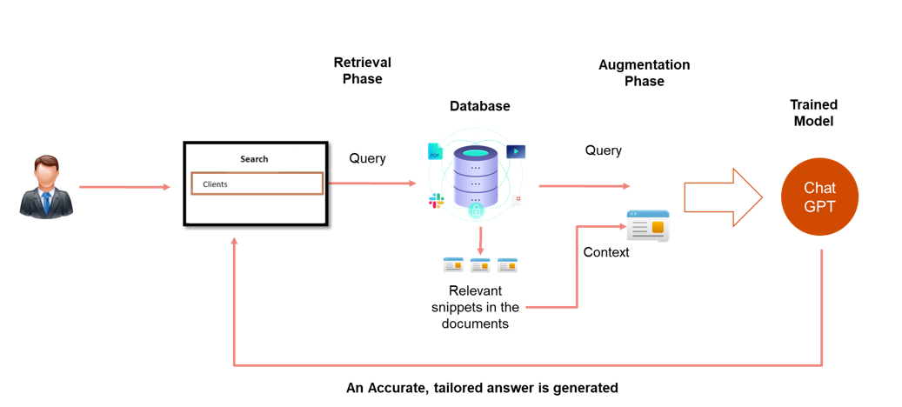
Retrieval-Augmented Generation (RAG)
SUGCZ 2024
SUGCZ
Banking

Slide 7
Retrieval-Augmented Generation (RAG)
SUGCZ 2024
SUGCZ
1. Overview of RAG:
  Enhances responses with contextually relevant data extracted during the generation process.
2. How RAG Works:
  Retrieval Phase: Queries a large dataset or document corpus to find relevant information.
  Augmentation Phase: Integrates the retrieved information with the capabilities of a generative model (like GPT) to create detailed, informed responses.
3. Benefits of RAG:
  Improved Accuracy: Access to specific data during generation leads to more accurate and relevant outputs.
  Context Awareness: Capable of understanding and integrating context, which enhances the depth of interactions.
  Scalability: Effective in handling large-scale information retrieval and integration with generative processes.

Slide 8


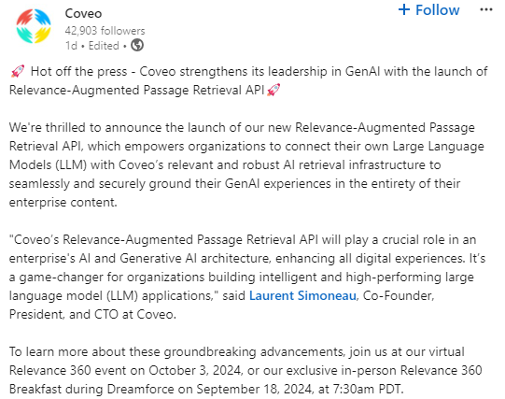
Coveo / Elastic Search
SUGCZ 2024
SUGCZ
Coveo
Supports Semantic Search with additional cost.
Relevance-Augmented Passage Retrieval API (Sept,2024) – new!
Regular API is available.
Elastic
It's easy to integrate content using connectors (Sharepoint, Google Drive).
Provides an API endpoint for searching.
Provides Semantic Search.
Additional cost.

Slide 9
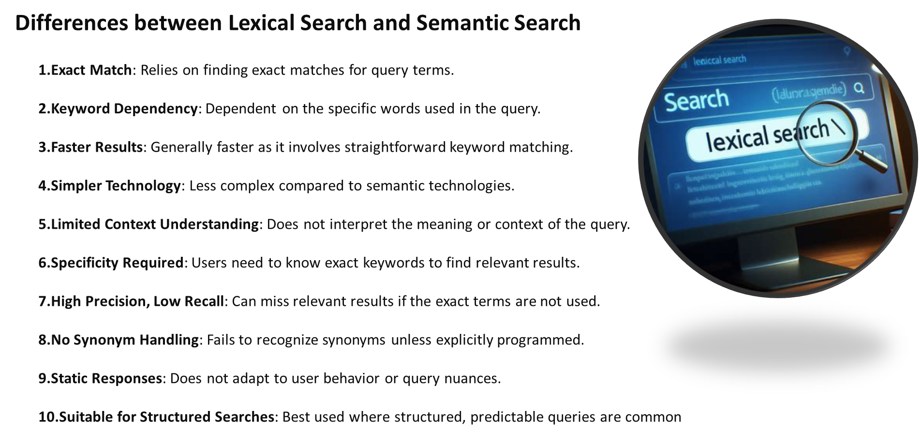
Lexical Search (traditional)
SUGCZ 2024
SUGCZ

Slide 10
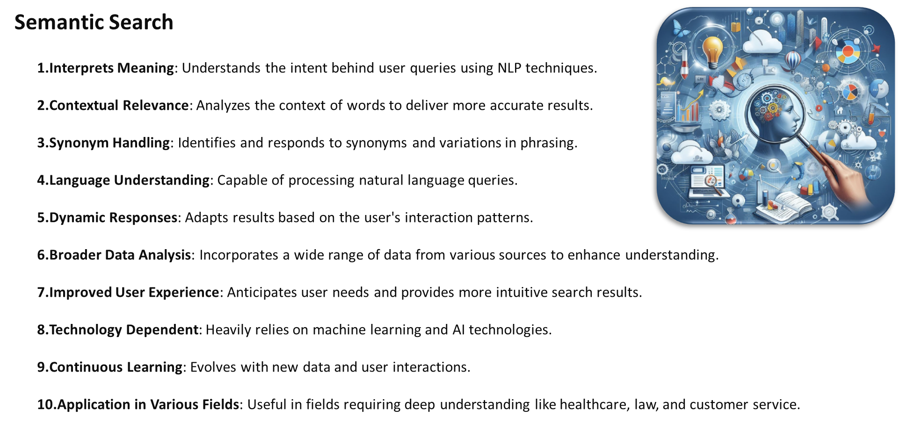
Semantic Search (beyond keywords)
SUGCZ 2024
SUGCZ

Slide 11


Usage of trained models
SUGCZ 2024
SUGCZ
Evaluation of Usage of
ChatGPT: Provides API Endpoint , most common used, There is a price involved in the number of calls
META LLAMA 3: Developed by Meta, this open-source AI model can be used locally for free and also offers an API endpoint.
Llama 3.1 was recently released on July 23, 2024, and is also available on Amazon Bedrock.

Slide 12
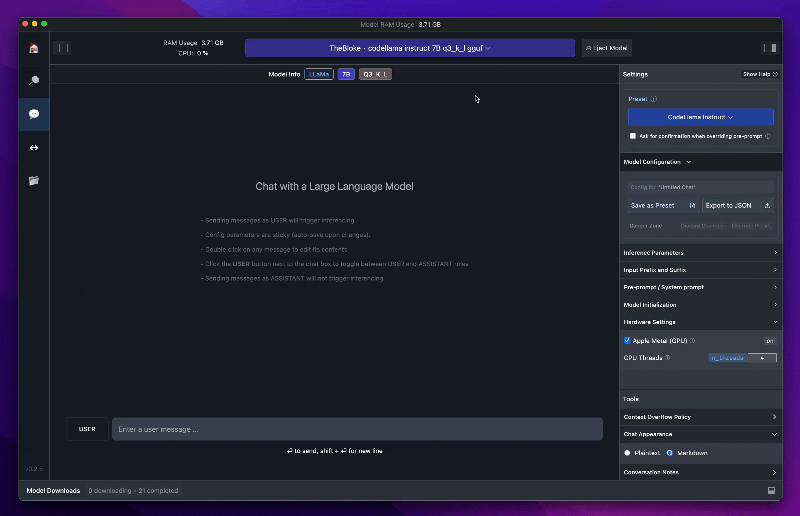
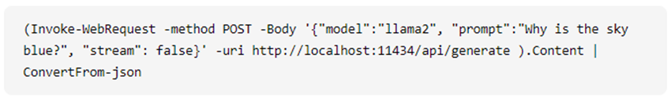
First Contact
SUGCZ 2024
SUGCZ
LM Studio:
User-friendly interface with advanced options for experienced users.
Visual tools and dashboards.
Local Inference Server. This feature allows you to host LLMs on your own server, providing unparalleled control and privacy over your AI environment.
Easy to set up.
Powered by OpenIA.
Easy access to multiple models (Llama2, Llama3, Phi, and others).
Ollama:
Open source tool for running LLMs.
Often associated with "LangChain" combined (Python).
Command line.

Slide 13
ChatGPT 4
SUGCZ 2024
SUGCZ
GPT-4 Omni : May 13, 2024
Multimodal Capabilities: ChatGPT-4.0 can now understand and generate both text and images, allowing users to upload images and receive detailed analysis or generate new images within the chat interface. This feature is powered by a combination of GPT-4 and DALL-E 3​​​​.
Voice Interaction: Users can engage in voice conversations with ChatGPT, leveraging advanced voice synthesis technology. This feature supports real-time voice input and output, making interactions more natural and accessible, especially through mobile apps​​​​.
Real-Time Browsing: ChatGPT-4.0 can perform real-time internet searches when necessary, ensuring that responses are based on the latest available data. This feature helps in providing up-to-date information and answers​​.
OpenIA o1 : September 12, 2024
Model Performance in Sciences: Performs similarly to PhD students on challenging tasks in physics, chemistry, and biology.
Math Abilities: Strong performance in math, scoring 83% on a qualifying exam for the International Mathematics Olympiad (IMO), compared to GPT-4o's 13%.
Coding Skills: Excels in coding, reaching the 89th percentile in Codeforces competitions.

Slide 14

SUGCZ
Use Cases
Real case scenarios

Slide 15
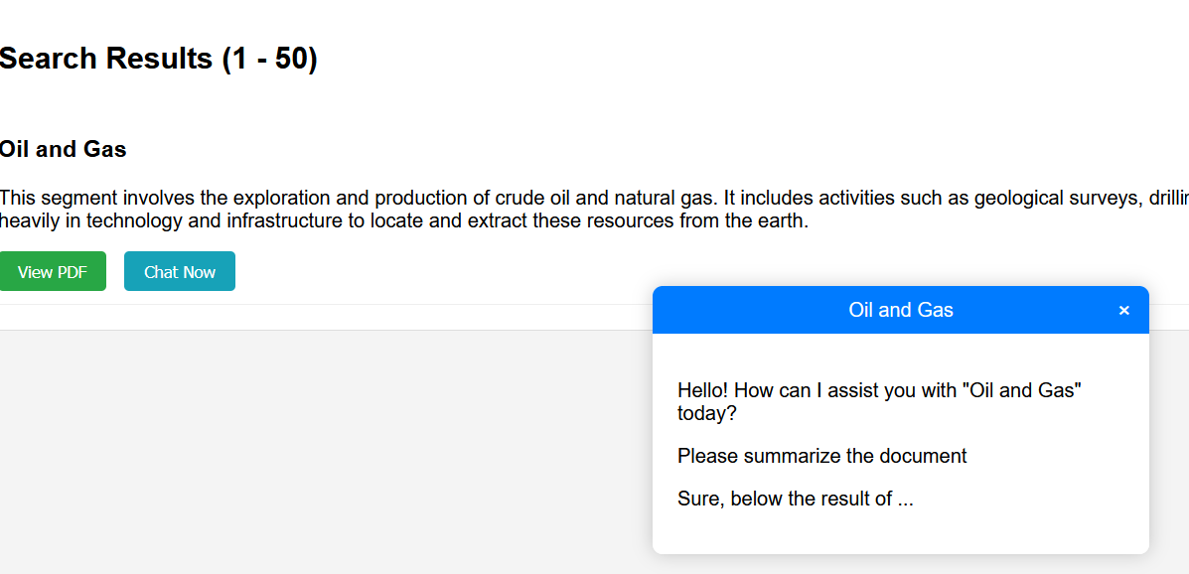
Chat with the document
SUGCZ 2024
SUGCZ

Slide 16

Chat with Favorites
SUGCZ 2024
SUGCZ

Slide 17
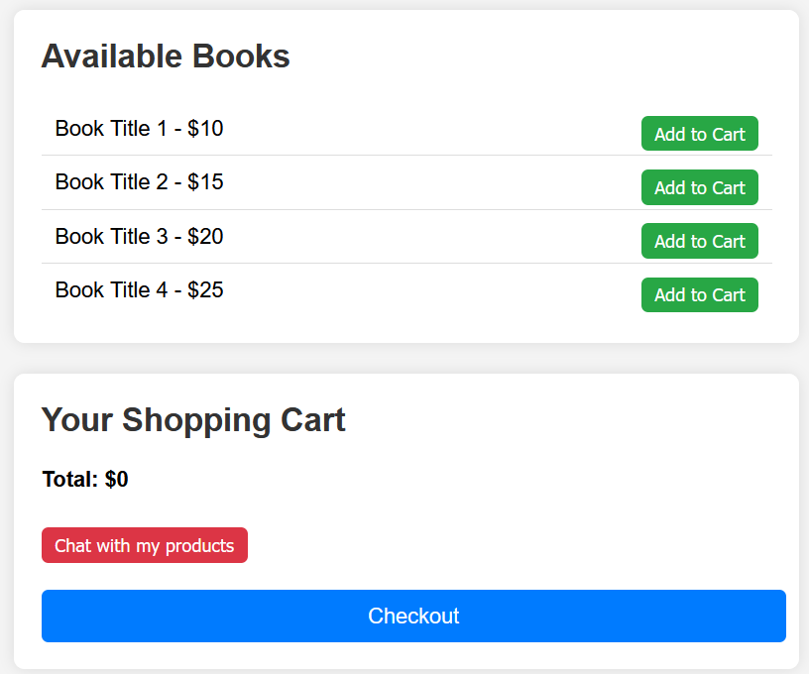
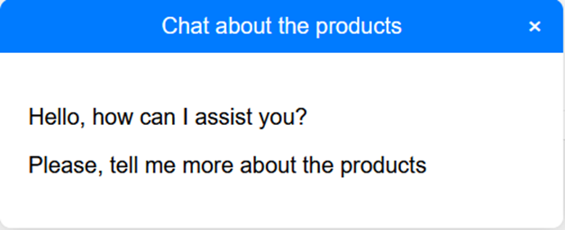
Shopping Cart
SUGCZ 2024
SUGCZ

Slide 18

Improve Accessibility
SUGCZ 2024
SUGCZ
Improve accessibility
Generate the Alt Text, based in the Image.
What is the Alt Text ?
Alt text (alternative text) is a brief description of an image used by screen readers for accessibility. It's also useful for search engines and when images fail to load.
There is a similar feature already in Sitecore Content Hub

Slide 19
AI for Developers
SUGCZ 2024
SUGCZ
What is GitHub Copilot?
  AI-powered Code Assistant: An AI tool developed by GitHub and OpenAI to help developers by suggesting code snippets, entire functions, or completing lines of code.
  Seamless Integration: Works within popular code editors like Visual Studio Code.
Key Features
  Autocomplete Code: Predicts and suggests the next lines or blocks of code.
  Code Suggestions: Offers suggestions based on context and the code already written.
  Multi-language Support: Supports a wide range of programming languages.
  Learning from Context: Understands and adapts to the coding style and context of the project.

Slide 20
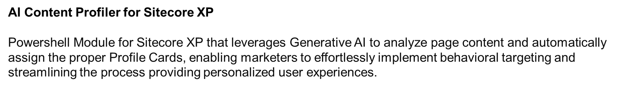
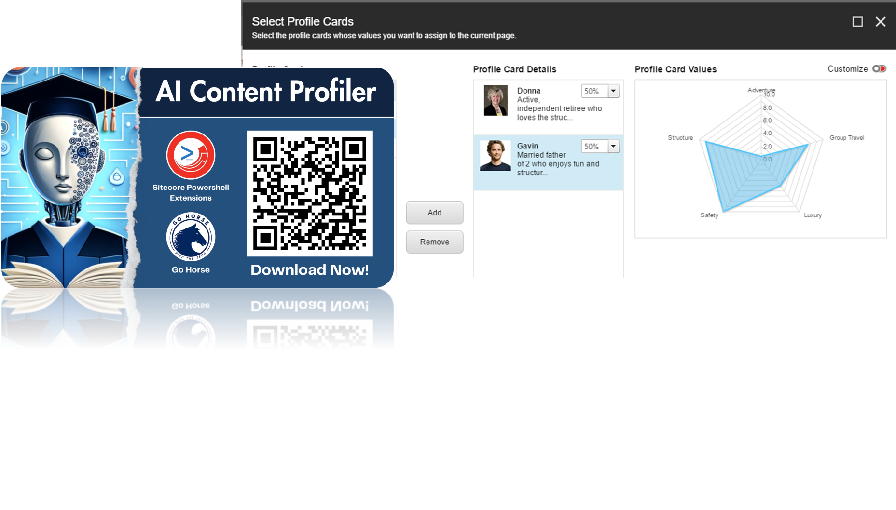
AI for Marketers
SUGCZ 2024
SUGCZ

Slide 21
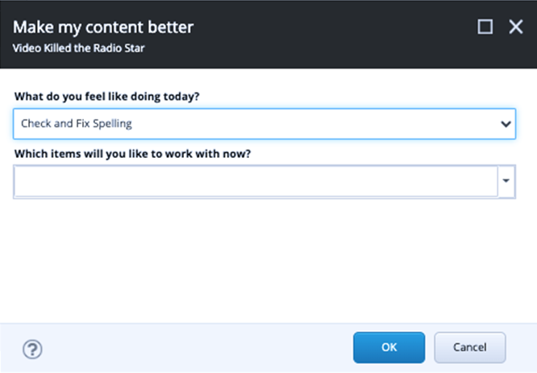
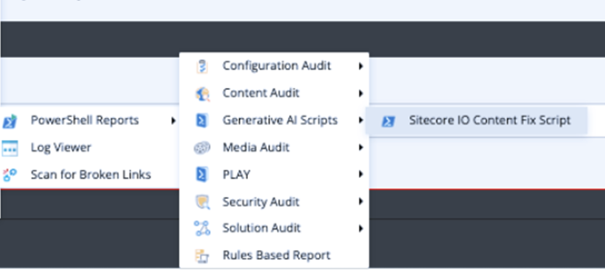
AI for Content Authors
SUGCZ 2024
SUGCZ
Check and Fix spelling
Translator
Rewrite Text Content
https://github.com/Sitecore-Hackathon/2024-Sitecore-io

Slide 22
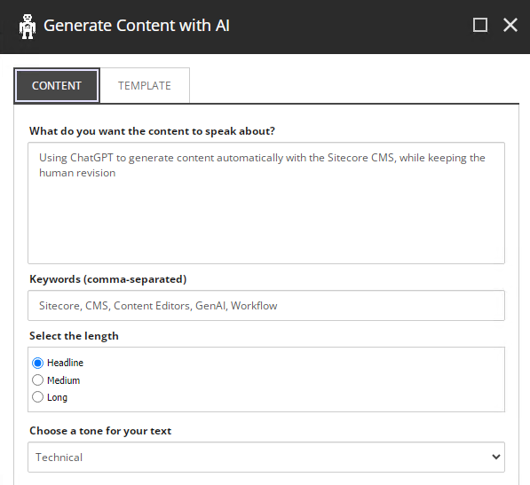
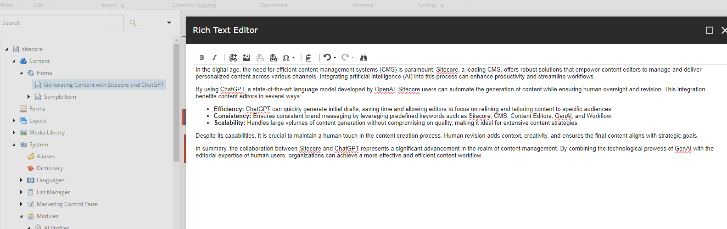
AI for Content Authors
SUGCZ 2024
SUGCZ
Prompt : generate an image with the text “coming soon”
https://github.com/peplau/Sitecore-GenAI

Slide 23
AI for Everyone!
SUGCZ 2024
SUGCZ
Role | Tool
End User | Chat with Document/Favorites
Developer | GitHub Copilot
Marketer | AI Content Profiler for XP
Content Author | SitecoreIO, SitecoreGenAI

Slide 24
SUGCZ
"The future of artificial intelligence is not about man versus machine, but rather about man with machine."
Fei-Fei Li

Slide 25
SUGCZ
Thank you!
José Neto
Do you have any questions?
Solutions Architect
Joseam.neto@live.com
Slack : joseneto
Linkedin : jose-neto-mvp
Main sponsor

