Slide 1

Delivering Smaller JS/CSS files
Optimizing and performance
Notes:
Hello everyone, I appreciate your time, and the opportunity to be here sharing this presentation with you
Today, I will talk about a very important topic related to web development, which is the performance, in this presentation I will try to share, some knowledge, and way to improve the user experience on your Sitecore website.

Slide 2

A few words about me
José Neto
Sitecore Developer at NishTech
5 years on Sitecore Platform
Sitecore Certified Developer (2x)
Sitecore MVP 2018/2019
Blog
Go Horse Team Sitecore Hackathon
Notes:
A few words about me
My name is Jose Neto, I’m currently a Sitecore Developer at NishTechInc
I’ve been working with Sitecore in the last 4 Years and Certified twice
I was also awarded the Sitecore MVP two times
and I try to help the community by sharing the knowledge through my blog.
I’m also a proud member of Go Horse Team on Sitecore-Hackaton)
If you don’t know what Is The Sitecore Hackton is,
Well, It’s annual competition promoted by the Sitecore community, that gathers teams around the world in order to build modules in 24 hours, it’s really cool!
And our team won in the xConnect Category this year!

Slide 3
Experience is the key
Notes:
If you have been in the Symposium this year , you will remember we keep talking about Experience.
Even Orlando Airport there was a message from the Mayor saying something like “We hope that you enjoyed the Experience in Orlando”.
And we should apply this concept for our website

Slide 4

Part of the Experience is...
Market demands faster pages
Notes:
One of the pillars of a good Experience special when we are talking about websites, it’s the performance and
More and more, the market drives us to develop faster and more reliable applications, currently, the performance is another keyword in web development, and Downsizing files is crucial to succeeding. The number of bytes delivered to the browser is very important, we should consider that many clients will have a relatively underpowered mobile device or slow internet connections and that is true in most part of the developing countries where the next billion internet users will come online in the upcoming years
Faster pages means better conversion, which is essential for Digital Marketers.
There are many ways to try to improve the performance of a Sitecore website, this can be done using cache, or you can scale vertically or horizontally, or you can use Sitecore Debug, to check how long a rendering is taking to load, or you can use Ajax to avoid the page to reload, all are valid and should be used as well, but today we will focus the discussion in bytes delivered to the client

Slide 5

Project Structure
Notes:
PROJECT STRUCTURE
Here we can see a normal project structure in Visual Studio, which contains some javascript files, each one with designed to fulfill a requirement for a specific situation. In this example, we can see ”vendor-date-valid” which is usually used in forms, with this file, the developer can perform validations on a form, but probably it will not be used in all the pages, since not all the pages will have forms, another file is the “reschedule-appointment”, a javascript designed for a feature or a page, It contains the code that allows the user to perform such action, so both files, separated in the project, containing different functions. We can also see the search.js which allows the user to find some content on the website.

Slide 6
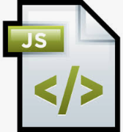
Bundled File
Single file
Notes:
Let's consider that most projects in a CMS will have the correct architecture, with divided files internally on the project, but usually, in the end, those files will be bundled and delivered in the web browser in one single big file. And Why ? well This is a challenge imposed due to the own nature of a CMS, any content author can add multiple components in a page, which means the result of bundled.JS or.CSS files will contain all the necessary files to run all the components available on the CMS, in most of the cases, all dependencies code. and that creates the issue, Why deliver the “vendor-date-valid.js” on a page that this file is not required? Or why deliver reschedule-appointment file in a page that does not contain this feature? That will just send unnecessary extra bytes to the client.

Slide 7
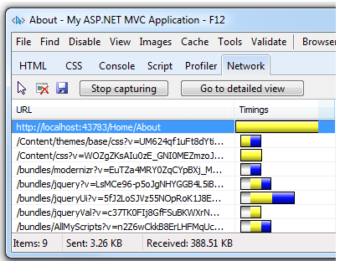
Bundle and minification
Notes:
Bundle and Minification
So,What is Bundling ? According to Microsoft
Bundling is a feature that makes it easy to combine or bundle multiple files into a single file. You can create CSS, JavaScript and other bundles. Fewer files means fewer HTTP requests and that can improve first page load performance.
Minification
Minification is a process that performs a variety of different code optimizations to scripts or css files, such as removing unnecessary white space and comments and shortening variable names to one character.
Those two process, are widely used on all the pages on the web.

Slide 8

How this is used – traditional approach
Notes:
This slide shows images with the standard code used for configuring the bundle,
In the first image we can see the usage of WebActivator.
Which is NuGet package that allows the developer to bring Startup and Shutdown code into the application.
We can see the Usage of PreApplicationStartMethod and this will make , the startup method will run the code in the initialization of the website. Creating the bundles, at the very beginning.
In this example we have two Javascript files, one which is “reschedule-appointment and vendor-date-valid”, the final result of those two files will be the
called “global.js”., this will generate the bundled file . We can notice even they look very unrelated, they are bundled together, allowing that both renderings can be used at any time .
And this is the traditional approach and widely used.

Slide 9

Pages and files
Files | Filesize
Bundled file/features | 100k(not considering the minifcation)
Reschedule-appointment.js | 30k
vendor-date-valid.js | 20k
Other js | 50k
Form Page -100k
Reschedule-appointment -100k
Notes:
So, in this example the bundled file, will have around a hundred k (100k)Not considering the minification)
Reschedule-appointment-30k
Vendor-date-20k
And other js together around 50k , so regardless the rendering that is being used on the page, the code is delivering the same number of bytes decreasing the user experience, overloading the network, and the data consumption.

Slide 10
Let’s change that
Form Page -25k
Reschedule-appointment -35k
Notes:
The objective will be the reduction of unnecessary code delivered to the browser, since it contains only one rendering, the code will deliver just the necessary javascript to run that SPECIFIC rendering instead of delivering a big bundled file
, this will make a good reduction in the number of bytes sent to the client browser. In some projects we can see this attempt of reduction being done by a different technique, using Sitecore layout, In that case, The form Page could have a different layout of the other pages with their specific list of java scripts and CSS files.

Slide 11

How to deal with that ?
Rendering Form
Rendering – Schedule Appointment
Notes:
The Question is , How to deal with that in a smarter way?
Well , In Sitecore, the solution will come making some association between the Rendering and their direct dependencies, which can be javascript files and/or styles files, but We need to know this is feature is not natively built-in Sitecore, for that, we will need to get a module from Habitat.
in this case, we will use just the necessary projects in your solution to implement this functionality
People tend to think that Habitat is a Starter KIT but
Please, Remember DO not use HABITAT as a Starter Kit

Slide 12
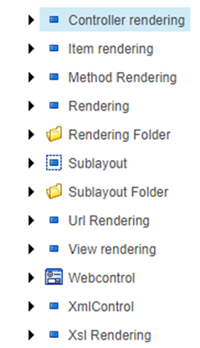
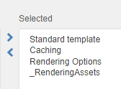
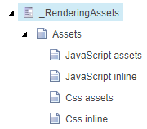
Changes on the renderings
All the renderings will change,(Item Rendering,View Rendering, Controller Rendering)
Notes:
After you incorporate the code into your solution which is called “Sitecore.Foundation.Assets”,
The native renderings will start to show up new fields, this is due to the inclusion of the _renderingassets Template,
Which contains those fields items, This change will be performed on Controller Rendering, Item Rendering among other renderings.
Two main important fields are the “JavaScript Assets” and “CSS assets”.

Slide 13
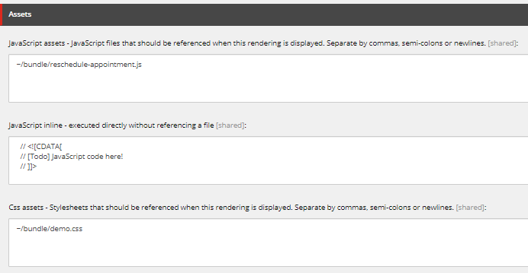
Making the association
Project “Sitecore.Foundation.Assets” will add new fields on the Rendering
Notes:
Making the association.
With the new fields in your hands
The developer must insert their dependencies, note that is even possible to add some Inline Javascript.
On this example, the dependency is called “reschedule-appointment”. The field also allows multiple javascript files. In order to do that, you must use commas, semi-colons or newlines. This feature enables you to add for example a tracker or any other code that you may need for one specific page .
For the form rendering, we would need to add vendor-date-valid javascript, in this example, we added demo.css
And It’s also possible to add some inline CSS if necessary. On the field called “CSS Inline”.

Slide 14
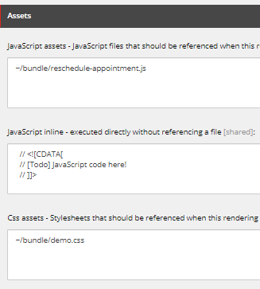

The result
All the dependencies for that rendering will be inserted
Notes:
The module will dynamically insert the dependencies on the page, and that will help us to delivery smaller files to the client, and reduce the Page load time
It’s important to remember that Search engines, uses the Page load as metric to score our website as well, and it may affect your page ranking.
So, and everybody is happy right?
Well, It seems it’s all over, but if you have a closer look, something may be missing, That file is not MINIFED,
When you use the Bundle Strategy, Usually the file is minified by the bundling feature, so now you have another issue, the code is delivering non-minifed files! and actually, you are increasing the number of bytes!

Slide 15

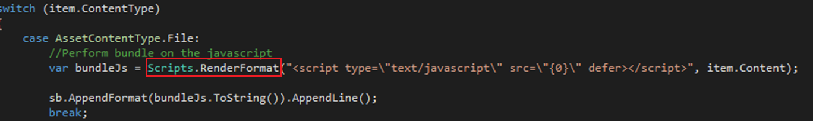
Bundled + Assets Module
Notes:
In this case, we will need to perform some change on the module.
We will need to introduce the “Script class” which is part of the SYSTEM dot WEB dot OPTIMIZATION namespace, so here the class used to minify the files will be introduced on the code.
In this example, the change is applied only to the JavaScript piece, but a similar change must be performed on the code that handles the CSS reference as well
Note that I also added the “defer” attribute on that reference :
The defer attribute tells the browser to only execute the script file once the HTML document has been fully parsed.
Since JavaScript is considered a “Blocking resource” this attribute, will interfere with the time to first paint.
Of course, you can customize this, in your own way, using the defer attribute, the async attribute, or no attributes at all depending on your needs.

Slide 16
BundleConfig Optimization
Implement a new strategy of dynamic bundling
Read the files and dynamically create the bundles
Notes:
Another change will be on the BundleConfig which contains all the files that will be optimized.
In this case,
We will use a new approach, in this strategy the code will dynamically identify the assets files, and create the bundle files.
But how is this done ?

Slide 17
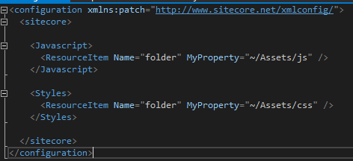
Automatic Bundles
Define the folder of the assets
Notes:
Well, first we need to set up a config file and point to the folder where the project has their assets, it can be multiple folders for javascript or styles.
The first node contains the List of folders that holds JavaScript files
The second one, contains the list of folders that holds CSS files

Slide 18
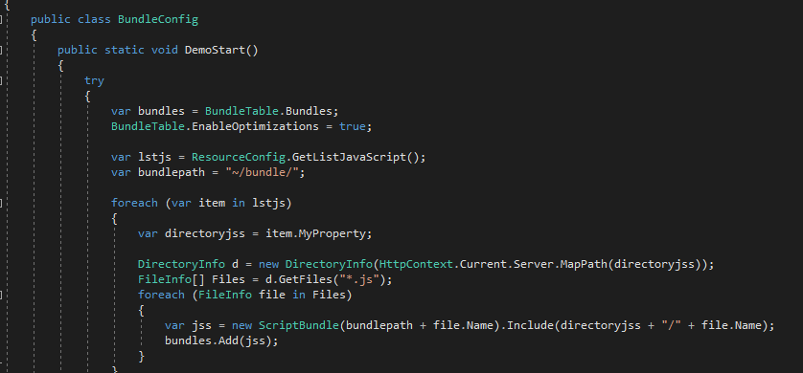
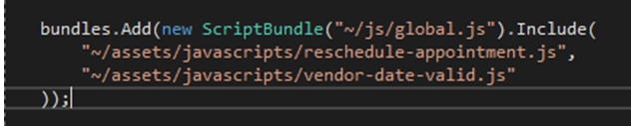
Dynamic identification of the files
Before ….Multiple
Notes:
Another change will be on the BundleConfig,
Usually we can see a lot of bundle files being added to this part of the code, one for each file, or multiple into one single big file.
On this slide , there is a suggestion that will dynamically identify all the css and java scripts files, and it will generate a single.
First, We also need guarantee the use of PostApplicationStartMethod, otherwise the HttpContext will be null.
The code will implement a logic that reads those config files, identify them, and generate a specific bundle for each file .
So, instead of manually typing each js or css as usually is done, the code will create the bundles dynamically based on the config files , allowing them to be used on the Renderings.

Slide 19
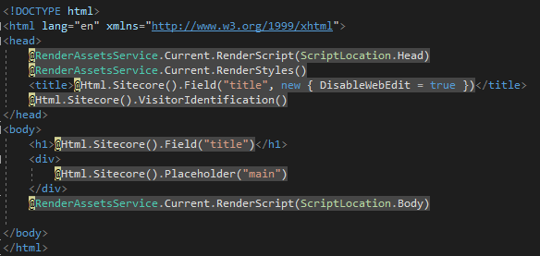
Layout
Change on the Layout
Notes:
We just cannot forget the changes on the Layout ,
Here it is place were the code will inject the references.
On the layout you still need to put the call to “Rendering Assets Service”, which will call our customized method, plus the changes that we made that will minify the files.
As we can see, the first call is on the HEAD which will render the Inline JS, and the second will write the references to the Styles.
In the middle we will have just normal code, like placeholders, h1 tag, and other stuff.
And at the bottom , it will render the bundled js references

Slide 20
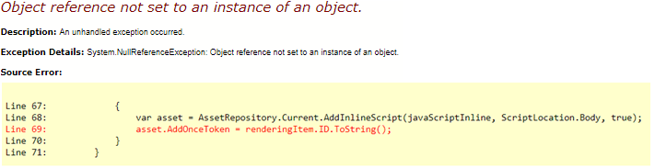
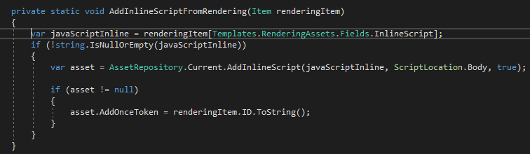
Bug Fix – two renderings
Bug for js– habitat 1.6
Notes:
Well, when I was doing my tests I saw an issue, That is why I had to make this small Improvement..
I faced an RunTime error, It may be due to an version that had locally, but it seems
There is a situation where you may have the exactly two renderings on the same Page, and It will work, except if you have some JavaScript on the field inline code, for that
There is a minor change that must be applied in order to fix the issue.
A simple check for null will do the trick, and now your page can have two renderings , plus some inline JS and it will work just fine.

Slide 21
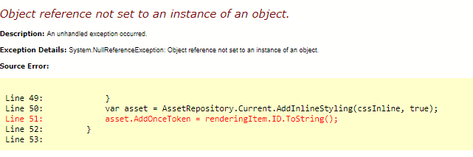
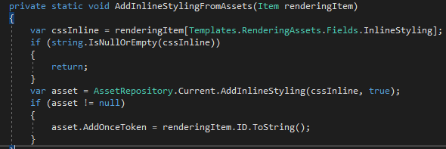
Bug Fix – two renderings
Same bug fix for CSS – habitat 1.6
Notes:
On the arrow we can see a similar code that handles the CSS BUNDLE.
So, Let’s apply the the same change for the method that handles the inline CSS.
Let’s apply the same check null.

Slide 22
The final result
Smaller files
Less “$(document).ready()” being loaded
Notes:
The outcome of that on HTML, it will be some additional characters on a reference as shown in the red box, this will guarantee you the bundle is being also integrated with the Habitat module, the file will be minified.
Another important benefit is the reduction of the number of javascripts loaded, usually, there are a considerable number of routines being executed after the document has been loaded, this may also increase the performance of the page
The final result of this is a change on the way that we correlate the renderings and their dependencies, the gains of using this technique is remarkable.
The reduction of delivered bytes to the clients and their devices should be encouraged and it’s a tendency.

Slide 23
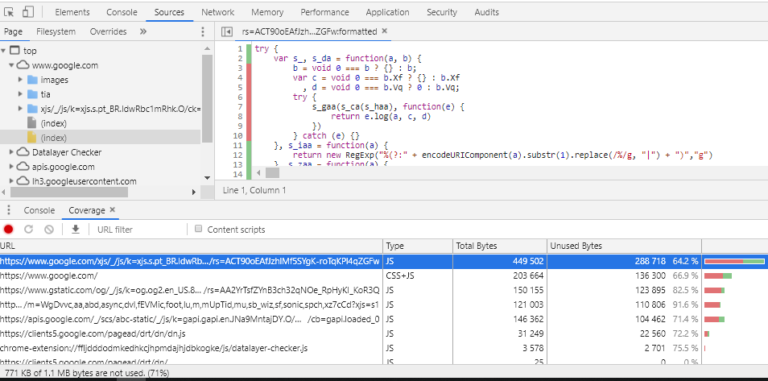
Validation
Google chrome tool
Notes:
Validation
Google Chrome offers a tool that helps the team to Identify some bottleneck files that are being loaded and not being used.
The small arrow points to the Tab called “Coverage” show you some information regarding the usage of code
We can see the Url, The Type , the Total Bytes, and the Unused Bytes , The last, unnamed column is a visualization of the Total Bytes and Unused Bytes columns. The red section of the bar is unused bytes. The green section is used bytes.
Do you see the Big orange Arrow? That shows part of the code that is not being used
It’s important to take a closer look and test after the changes on the files, since , some functions can be only triggered after some events, like resizing, and this may not be perfectly covered by the tool
In general this tool is an important ally, we should take this tool into consideration when looking to files or functions that can be removed from the bundled and fix their dependencies.

Slide 24

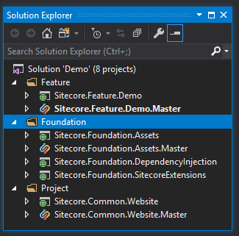
DEMO
Let’s do that !
Notes:
In order to demonstrate the result, I created a example project , containing everything that you needed to apply on this solution.

Slide 25
Thank you
joseam.neto@gmail.com
http://errorcotidianam.wordpress.com – Sitecore Day by day issues faced by Developers, Marketers and Content Authors
Notes:
Thank you very much for your time
I hope you enjoyed this presentation, and this can help you deliver better and faster websites!
I have more information on my Blog, Called Error COTIDIANAM, which you can find day by day issues faced by developers marketers and content authors.
Thank you

Slide 26

Questions and Discussion
Make your question !
Notes:
Now we have some time to open for questions and discussion

